Slide 1
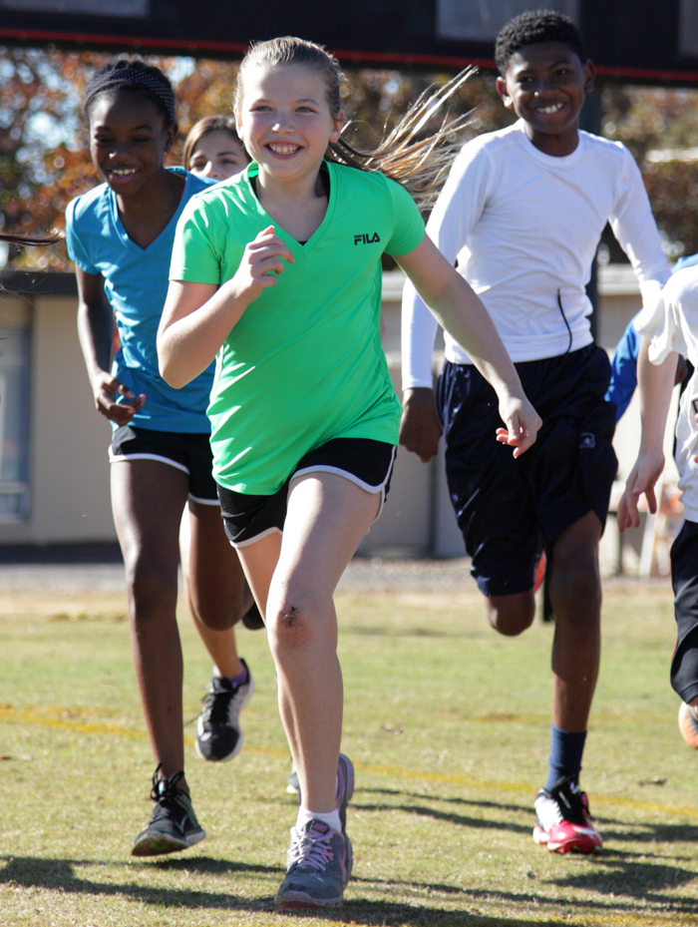
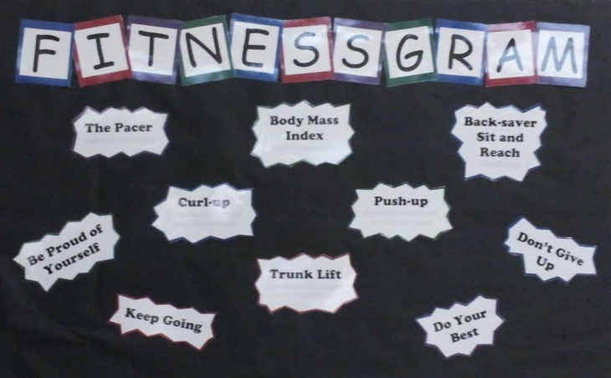
FitnessGram Assessments Lisa Burleson-Longino

Slide 2
 | Aerobic Capacity | Flexibility | Muscular Strength | Muscular Endurance | Body Composition
Grades | PACER or One-Mile Run | Back-Saver Sit and Reach | 90º Push-Up | Curl-Up | Ht and Wt
K-3 | FAMILIARIZE | FAMILIARIZE | FAMILIARIZE | FAMILIARIZE | INDIVIDUAL- OPTIONAL AGGREGATE REPORT
4-12 | INDIVIDUAL AND AGGREGATE REPORT | INDIVIDUAL AND AGGREGATE REPORT | INDIVIDUAL AND AGGREGATE REPORT | INDIVIDUAL AND AGGREGATE REPORT | INDIVIDUAL AND AGGREGATE REPORT

Slide 3
Exemptions for Students with Disabilities
For exempting students from fitness assessments, use your school system’s procedures for exempting students from physical education.

Slide 4
General Assessment Guidelines
All students should have the opportunity to practice ALL protocols prior to assessments.
Teach the importance of each fitness assessment and component area as it relates to health.
Emphasize the Healthy Fitness Zone.
Rule of Two: On second correction, assessment is complete (PACER, Push-Ups and Curl-Ups).
If, at any point, a student appears to be in extreme discomfort or pain during any fitness assessment, the fitness assessment should be discontinued immediately.
Notes:
There are some general guidelines that are important for you and your students to know.
1. All students have the opportunity to practice and LEARN how to perform the protocols correctly before actually being assessed. This is very important for all assessment items!! This is why it is important for elementary teachers to start teaching the proper way to perform the assessments in grade 1. This will to ensure students are able to perform the assessment correctly when assessment time arrives. Since many schools across the state have not implemented Fitnessgram, it will be especially important to take time to teach and let students practice the various assessment items before actually administering the assessment.
2. It is also important for the kids to understand WHY these assessments are important and how it relates to their health and not their ability to be an athlete.
3. Therefore, really emphasize the Healthy Fitness Zone.
The Rule of Two is used with the PACER, Push ups and Curl ups. it means that a student can be corrected one time and continue, but the assessment is finished the second time he/she is corrected. Therefore…the Rule of 2.
A general safety procedure for all assessments should be followed at all times. It is critically important that you warm up and prepare your students for the assessments AND watch them throughout the testing period. If, at any point, you see a student who appears to be in extreme discomfort or pain during any fitness assessment the fitness assessment should be terminated immediately!

Slide 5
Assessment Process
Read It
Show It
Do It
Review It
Notes:
A process for teaching the fitness assessments that appeals to all styles of learning is as follows:
Read It: PE teachers can do this in a variety of ways with their classes depending on the grade level. You can read the directions from the FG manual, you can use the slides we are about to share, you can use station cards. Just be sure students see the directions in writing.
Show It: Next show them what it looks like. You can do this using the Fitnessgram DVD that will be provided in the manual or by demonstrating yourself or with another student. If using a demonstration, it is important to have a student that you KNOW can perform the assessment correctly before putting them out in front of the class.
Do It: Allow ALL students to practice the assessment items before the assessment date. Build these assessment items into your warm ups or station work so kids have multiple opportunities to practice. Be sure you provide feedback for both proper and improper moves.
Review It: Take time to review the assessments often. It is critically important that students know and can demonstration the proper protocol and are prepared for the assessments. Therefore it is critical that you know the protocol as well. Reviewing it over and over will help.

Slide 6
FITNESSGRAM
Assessment Items:
PACER or One-Mile Run
Curl-Ups
90º Push-Ups
Back-Saver Sit and Reach
BMI
Notes:
The Georgia Board of Education selected FITNESSGRAM as the assessment that will be used statewide after a thorough review of current fitness assessment programs and upon recommendation of an expert advisory committee.
These are the assessment items that have been APPROVED and will be REQUIRED of all schools to administer to students of all grade levels. Again, students in grades 1-3 need to learn how to take these assessments and perform them properly.
There are other assessment items that you can choose to do, but these are required:
PACER or One Mile Run – measures cardiovascular fitness
Curl-Ups – measures abdominal strength/endurance
Push-Ups – measures upper body strength/endurance
Back Saver Sit & Reach – measures flexibility of lower back and hamstrings
BMI – measures body composition using height and weight

Slide 7
Healthy Zone FitnessGram Chart

Slide 8
P.A.C.E.R. Progressive Aerobic Cardiovascular Endurance Run
What does it measure? | Aerobic capacity
Why is it important? | Aerobic fitness is the single most important health indicator. Reduces risk for heart attack, stroke and other diseases. Allows you to do more activity.
How is it done? | Line up behind the start line. On start command, run to the opposite line before you hear the beep. At the sound of the beep, run back to the start line. Keep running until you have missed 2 beeps or your teacher stops you. When finished, walk to cool down.
Notes:
Let’s take a look at the fitness assessments to be used. Again remember, you can use these slides with your students in a lesson or use as station cards or handouts.
Review slide:

Slide 9
PACER (cont.)
Safety Considerations | Remind students to PACE themselves. Don’t go out too fast. Ensure that each student has a 40 to 60 inch wide lane for running. Watch for undue fatigue. Ensure students cool down properly after assessment. Make sure students have proper footwear.
Scoring | The score is the total number of laps completed by the student. First miss counts, second miss ends assessment and does not count.
Tips for Success | A triple beep signifies end of level and an increase in speed. Listen for triple beep.
Notes:
After going over info on slide, show the DVD.
Ask teachers if anyone has questions.
Has anyone administered the PACER? Experiences? Challenges?
Common errors:
Students begin too fast.
Students do not pace themselves.

Slide 10
One-Mile Run
What does it measure? | Aerobic capacity
Why is it important? | Aerobic fitness is the single most important health indicator. Reduces risk for heart attack, stroke and other diseases. Allows you to do more activity.
How is it done? | Measure a flat distance of one mile (1,760 yards) with as few laps as possible. 2. Students begin running on the signal “Ready, Start.” Students run the number of laps required to equal one mile. When crossing the finish line, elapsed time should be recorded.

Slide 11
One-Mile Run (cont.)
Safety Considerations | Remind students to PACE themselves and not go out too fast. Always warm up before taking the test. Watch for undue fatigue. Walking is permitted. Ensure students cool down properly after test. Make sure students have proper footwear. Avoid testing in unusually high temperatures or humidity or very windy conditions.
Scoring | The score is the number of minutes and seconds it takes to complete the one-mile distance. Calculation of aerobic capacity in the WELNET System requires a score of 13:01 or less.
Tips for Success | Use a measuring tape or cross country wheel to determine the course. Teacher/partner counts laps.

Slide 12
Curl-Ups
What does it measure? | Abdominal strength and endurance
Why is it important? | Promotes good posture and low back health.
How is it done? | Lie on back with legs bent, extending legs as far as possible with feet flat on floor slightly apart. Arms are straight, flat on mat, fingers stretched out and touching the closest edge of measuring strip. Curl up and slide fingers to other edge of strip in rhythm with CD, keeping heels on the floor. Back of head should touch the mat on each repetition. Continue assessment until second correction or complete curl-ups in Healthy Zones.
Notes:
Review slide content

Slide 13
Curl-Ups (cont.)
Safety Considerations | Stop students at 75 curl-ups.
Scoring | The score is the number of curl-ups performed. Curl-ups should be counted when the student’s head returns to the mat or paper. First miss counts; second miss ends assessment and does not count.
Tips for Success | Use the CD to encourage a steady, continuous movement . Watch for correct form. Instead of using the curling strips, create a tape line the width of the curling strip on one side of a mat. Then have students reach to the end of the mat. For some this is easier to feel.
Notes:
Curl-Ups Common Errors:
Head does not touch mat.
Fingertips do not reach the outer edge of measuring strip.
After going over this PPT slide, show the DVD.
Shoulders are shrugged up prior to start of assessment.

Slide 14
90º Push-Ups
What does it measure? | Upper body strength and endurance
Why is it important? | Important for daily living and promoting good posture.
How is it done? | Lie face down with hands under or slightly wider than shoulders. Straighten legs and back with toes tucked under. Push up off the mat with arms until arms are straight. Lower body until elbows bend at 90 degrees. Continue to rhythm of CD. Assessment ends at second correction.

Slide 15
90º Push-Ups (cont.)
Safety Considerations | Be sure arms do not bend past 90 degrees.
Scoring | The score is the number of the 90 degree push- ups performed. First miss counts; second miss ends assessment.
Tips for Success | You may use a nerf ball or other piece of pliable equipment that can be placed under the student’s chest to help them know what a 90 degree bend in the arm feels like. It may be helpful to make a recording with a voiceover that counts the number of 90° push-ups for the students (record the teacher counting over the cadence CD).
Notes:
Push-Ups Common Errors:
Body is not straight.
Hips sag towards floor or stick up.
Elbows not bent to 90 degrees in down position.
Knees touch floor.
After reviewing this slide, show DVD

Slide 16
Back-Saver Sit and Reach
What does it measure? | Flexibility
Why is it important? | Allows you to participate in a wide range of physical activities. It reduces injury, low back pain, and stress.
How is it done? | Remove shoes. Extend one leg fully and bend other leg with the sole of the foot flat on the floor 2-3 inches to the side of straight knee. Arms straight out in front, palms down, hands on top of each other, fingers even. Reach forward with both hands even, back straight and head up. Repeat 4 times and hold the position of the fourth reach for at least 1 second. Repeat with the other leg.

Slide 17
Back-Saver Sit and Reach (cont.)
Safety Considerations | Do not allow students to reach beyond 12 inches.
Scoring | Number of inches on each side to the nearest ½ inch reached, to a max score of 12 inches. BE SURE TO USE THE CORRECT SCALE ON THE BOX – INCHES
Tips for Success | Hands should reach forward evenly. The trial should be repeated if the hands reach unevenly or the knee bends.
Notes:
Sit & Reach Common Errors:
Fingers do not stay together.
Extended knee bends.
Fourth stretch not held for one second.

Slide 18
Body Mass Index
What does it measure? | An estimate of a person's body composition (muscle vs. fat mass) based on a person's weight and height
Why is it important? | High levels of body fatness are also associated with an increased risk of heart disease, stroke, and diabetes. Too much body fat inhibits performance and daily living.
How is it done? | Body Mass Index is determined using height and weight.

Slide 19
Body Mass Index (cont.) Measuring Height
How is it done? | Students remove shoes, heavy clothing, hats and barrettes. Have student stand with back and feet against wall on a flat surface. The height chart should run down the center of student’s back. Weight should be evenly distributed, shoulders relaxed, legs straight, arms at side, and buttocks and shoulders should touch the wall. Place rafter square against wall and lower it until the square firmly touches the crown of the student’s head.

Slide 20
Body Mass Index (cont.) Recording Height
How is it done? | 1. Record the measurement at the lower edge of square and height chart. 2. Round down to the nearest quarter inch.
Notes:
Height should be measured and recorded using feet and inches to the nearest quarter inch. For example, if a student measures between 5ft, 1 1/2 inches and 5ft, 1 ¼ inches, the height rounded down to 5ft, 1 ¼ inches. Fractions of inches will be represented by decimals. (1/4 = .25, ½ = .50, and ¾ = .75). Therefore, the height of 5ft, 1 ¼ inches would be recorded as 5ft, 1.25 inches.

Slide 21
Body Mass Index (cont.) Measuring Weight
How is it done? | Place scale on a solid, level floor and be sure scale is balanced or calibrated at 0 lbs. Have student empty out all objects in pockets and remove any bulky clothing (no jackets). Have student stand backward on the scale with feet centered on platform while taking the measurement. Record measurement to the lowest whole pound or tenth of a pound, if scale allows.

Slide 22
Body Mass Index (cont.)
Safety Considerations | Take height and weight measurements in a private location. Have each student stand on scale backwards to record weight.
Scoring | Record height and weight. **When measuring height, round down to the nearest quarter inch (¼=.25, ½=.50, ¾=.75). For example, a student measuring 5 ft 5^{3/4} inches would be recorded as 5 ft 5.75 inches.** **When measuring weight, record to the lowest whole pound or tenth of a pound, if scale allows. For example, a student weighing 112.4 lbs would be recorded as 112.40 lbs. **
Notes:
Keep in mind that the BMI is a calculation used to screen the general population for health risks related to having too much body fat. This is not a tool that works well for most athletes who are curious about their own body composition that includes lean mass and fat mass.

Slide 23
References
Corbin, C.B., Lambdin, D.D., LeMasurier, G.C. (2007). Fitness for Life Middle School (5th ed.). Champaign: Human Kinetics. Lund, J., Tannehill, D. (2010). Standards-Based Physical Education Curriculum Development (2nd ed.). Boston: Jones and Bartlett Publishers. Meredith, M. D., Welk, G.J., (2007). FitnessGram ActivityGram (4th ed.). Champaign: Human Kinetics. National Association of Sports and Physical Education (NASPE). Physical Best Activity Guide (3rd ed.). Champaign: Human Kinetics. Pangrazi, R. P. (2007). Dynamic Physical Education for Elementary School Children (15th ed.). San Francisco: Person Benjamin Cummings.

